Slide 1

WHO Life expectancy analysis on factors influencing life expectancy
Waail Abdalla

Slide 2

TABLE OF CONTENT
BUSINESS PROBLEM
KEY FINDINGS
RECOMMENDATION
Data Limitations

Slide 3

Business Problem
In this project, I have leveraged data from the World Health Organization available on Kaggle to construct a model with the aim of predicting various factors influencing life expectancy.
This dataset is comprised of data from all over the world from various countries aggregated by the World Health Organization (WHO for short). The data is an aggregate of many indicators for a particular country in a particular years. In essence, the data has multiple indicators in a time series separated by country

Slide 4

Methodology
Import the dataset.
Clean the data:
Set column names
Deal with missing values
Contruct visualizations:
Created boxplots to see the spreadness of data
Created histograms to see the distribution of data

Slide 5

Methodology
Contruct the multiple linear regression model:
Isolate modeling variables
Splitted data into train and test sets
Fit the model on training data
Evaluate the model:
Evaluated the trained model on training data
Coefficient of determination.
RMS
Evaluated the trained model on test data
Coefficient of determination.
RMS
Executed model result:
Calculated residuals
Created scatterplot between predicted and actual values
Find Coefficients

Slide 6

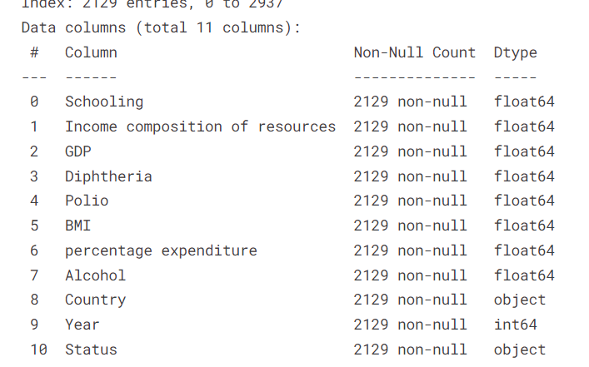
Findings
Multicolinearity
After 3 iterations, a collection of the top independent variables were used to create the final model. Using sklearn's feature selector the top 5 variables that have a strong relationship with the target variable price are:

Slide 7
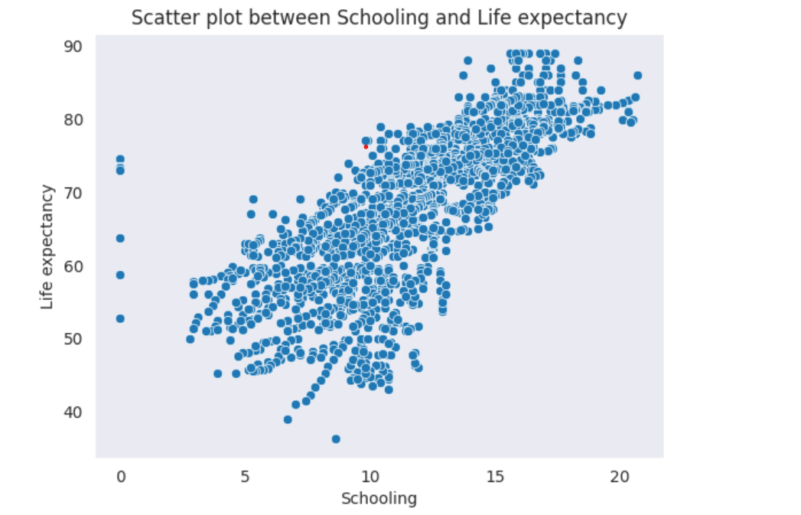

Slide 8
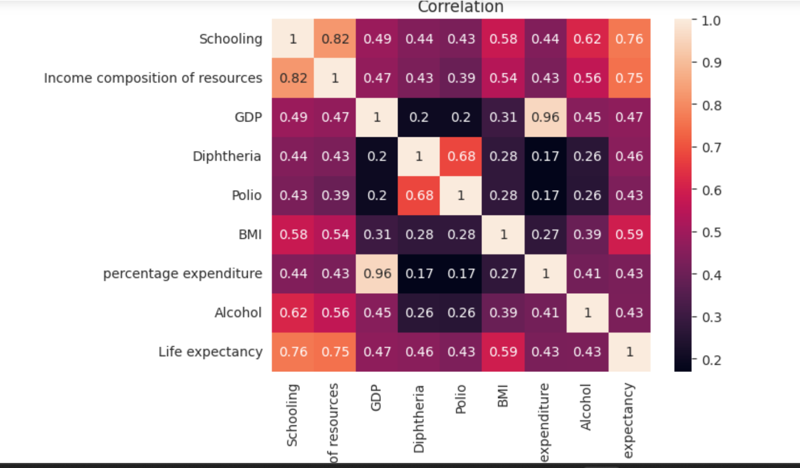

Slide 10
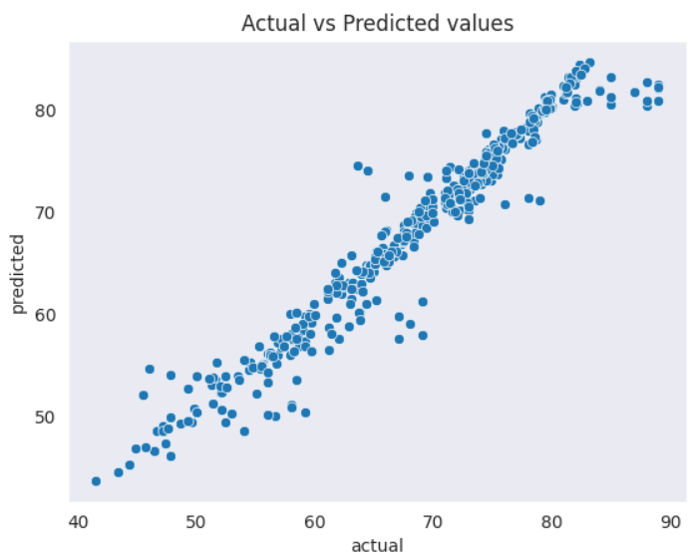
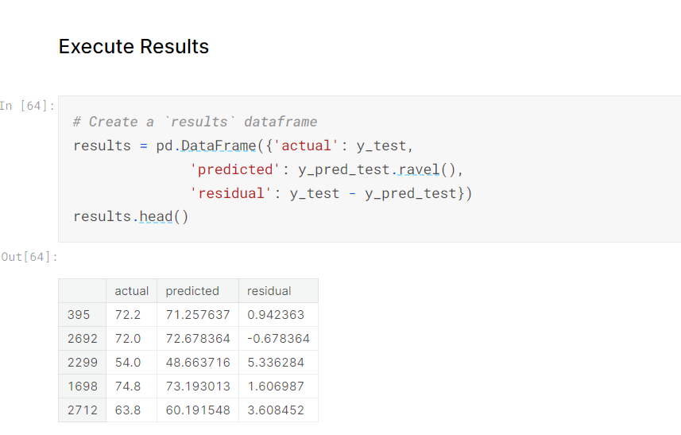
Regression analysis

Slide 11
Conclusion
The results of the model are promising.
The graph between actual vs predicted values show strong linear relationship.
The residuals are normally distributed.
This model has good coefficient of determination (R^2: 0.960) on training data.
The model has performed well on testing data with coefficient of determination (R^2: 0.938

Slide 12

LIMITATIONS
The dataset contains data till 2015, since then there have been many changes particularly in the economic situation, which has had great impact on government spend in particular , health care
Changing in GDP.
Interest rates.
Government spending.
Inflation
Post covid-19 situation
Policy changes
Information about employment rate and average salary of country for a particular year.
More analysis is required to determine the factors implicating life expectancy in developed countries and developing countries for example, on developing countries it may be lack of nutrition, education and healthcare.
On developed countries it may be stress, alcohol consumption and heart problems.

Slide 13



THANK YOU!
EMAIL: ALWALIWAAIL@GMAIL.COM
GITHUB: @WAAILABDALLA

